Slide 1

PowerCLI Lint
DC VMUG 10/17/2019
Justin Sider #vExpert
CIO - Belay Technologies Inc.
@jpsider
Invoke-Automation.blog

Slide 2
Agenda
Demo Environment
What’s Linting? It sounds gross!
Unit Testing
The Standard PowerShell tools
PSScriptAnalyzer
Pester
PSCodeHealth
Q&A
Easy to Read, Reusable Code
The Goal

Slide 3
My Demo Environment
Windows 10 -1903 (Yes it’s a MacBook)
PowerShell - 5.1
PowerCLI - 11.4
PSCodeHealth – 0.2.26
PSScriptAnalyzer – 1.18.0
Pester – 4.9.0
VSCode – 1.39.2
PowerShell Extension – 2019.09.0
vCenter Simulator
William Lam – Docker Container
https://github.com/lamw/docker-vcsim

Slide 4

What’s Linting? It sounds gross!
Identifies:
Styling issues
Violations of best practices
Comment based help exists
Code Complexity
This is a skill, the process is iterative, be patient! It will pay off!
https://github.com/PoshCode/PowerShellPracticeAndStyle
Unofficial
Guide

Slide 5
Styling Issues
Everyone wants to write the best 1 liner in the world….
$vm = Get-VM -VM "SomeName"
if($vm -eq $null) {Write-Host "No VM found"} else {Write-Host "Oh, Hey The VM exists!"}
More Lines are easier to read!
$vm = Get-VM -VM "SomeName"
if($null -eq $vm)
{
Write-Output "No VM found"
}
else
{
Write-Output "Oh, Hey The VM exists!"
}
Did you catch the other changes I made?
$null should be on the left side of equality comparisons.
Do Not use Write-Host
I hate this rule!
And this one!

Slide 6
Demo-01
Script Analyzer

Slide 7


Best Practices
See anything wrong with this?
Get-VM | % { Start-VM }
Do Not Use Aliases!
Get-VM | % { Start-VM }
Get-VM | ForEach-Object { Start-VM }
Technically both are correct. However the one on the right is easier to read.
VScode will highlight these for you!

Slide 8
Demo-02
Script Analyzer

Slide 9
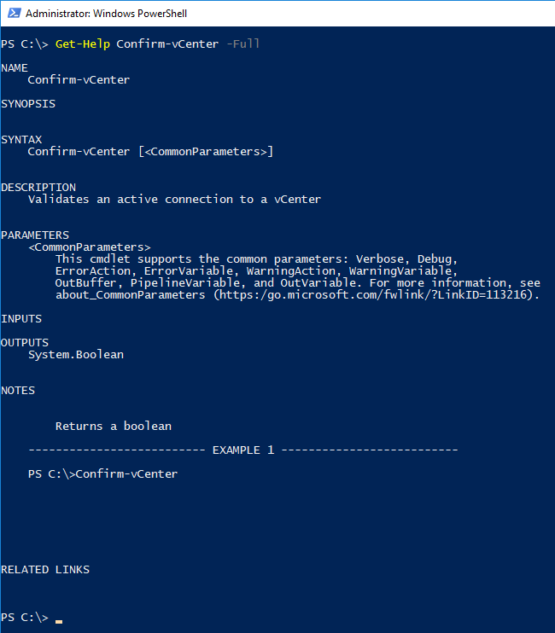
Comment Based Help
First things first…..
1 Function per File.
Second, add help!
<#
.DESCRIPTION
Validates an active connection to a vCenter
.EXAMPLE
Confirm-vCenter
.NOTES
Returns a boolean
#>
Just a few lines can be very helpful!

Slide 10
Demo-03
Error Handling
Comment based help

Slide 11
Code Complexity
Can you solve the problem with less code?
$Cluster = Get-Cluster
if ($Cluster = "Production") {
Write-Output "Do Production Stuff"
} elseif ($Cluster = "Pre-Prod") {
Write-Output "Do Pre-Prod Stuff"
} elseif ($Cluster = "Development") {
Write-Output "Do Development Stuff"
} elseif ($Cluster = "Infrastructure") {
Write-Output "Do Infrastructure Stuff"
} else {
Write-Output "Cluster Not found"
}
$Cluster = Get-Cluster
switch ($Cluster) {
Production { Write-Output "Do Production Stuff" }
Pre-Prod { Write-Output "Do Pre-Prod Stuff" }
Development { Write-Output "Do Development Stuff" }
Infrastructure { Write-Output "Do Infrastructure Stuff" }
Default { Write-Output "Cluster Not found" }
}
Reducing Code complexity makes Unit Testing a breeze! Nested If-Then statements make code very difficult to maintain. Break those up into multiple functions when possible.

Slide 12
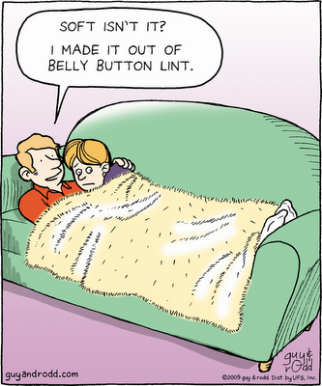
Unit Testing
What is it?
Why would you want it?
What’s Code Coverage?

Slide 13
What is Unit Testing?
It’s a process in which the smallest testable parts of your code are individually and independently scrutinized for proper operation.
Or…….. Your code does what it says. Each and Every time.
Example Code:
Param (
[Parameter(Mandatory)]$VM,
[Parameter()][string]$PowerState = "PoweredOff"
)
if ($VM.PowerState -eq "$PowerState"){
$true
} else {
$false
}
Set Up a fake VM Object
Example Test:
Describe "Confirm-PowerState function" {
$VMdata = @{
'Name' = "SomeVM"
'PowerState' = 'PoweredOff'
'Num CPUs' = '1'
'MemoryGB' = '2.000'
}
$returnData = $VMdata | ConvertTo-Json
$VMname = $returnData | ConvertFrom-Json
It "Should return True if the PowerState matches the desired value." {
Confirm-PowerState -VM $VMname | Should be $true
}
}
Execute the test with the fake object
If the PowerStates match, the test passes

Slide 14
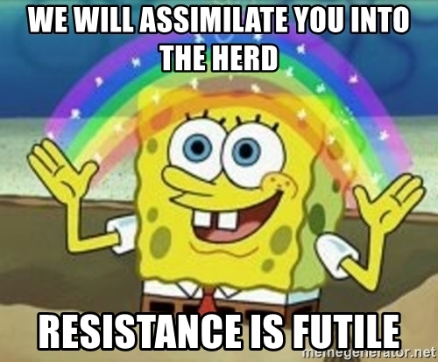
Why you should Unit Test your code.
We all make mistakes.
It will force you to write better code.
It will force you to break your code into smaller pieces.
You will be able to reuse more of your code.
You will be more confident in your code.
You will like coding/scripting even more
You will like unit testing…...
You will like unit testing…...

Slide 15
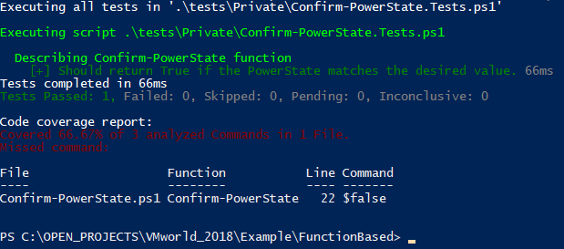
Code Coverage
Ensure that all of your script ‘Paths’ or script decisions are tested. The test from the previous slide only tested if the PowerState’s match. Should you always have 100% coverage? It’s a personal preference.
Invoke-Pester -Script demo04.tests.ps1 -CodeCoverage demo04.ps1
Pester has a Parameter to determine Code Coverage
It tells you which commands were not tested.

Slide 16
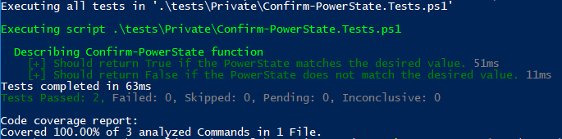
Code Coverage, cont.
Describe "Confirm-PowerState function" {
$VMdata = @{
'Name' = "SomeVM"
'PowerState' = 'PoweredOff'
'Num CPUs' = '1'
'MemoryGB' = '2.000'
}
$returnData = $VMdata | ConvertTo-Json
$VMname = $returnData | ConvertFrom-Json
It "Should return True if the PowerState matches the desired value." {
Confirm-PowerState -VM $VMname | Should be $true
}
It "Should return False if the PowerState does not match the desired value." {
Confirm-PowerState -VM $VMname -PowerState "PoweredOn" | Should be $false
}
}
Ensure that all of your script ‘Paths’ or script decisions are tested. The test from the previous slide only tested if the PowerState’s match.
New Test, where the PowerStates will not match
With the New test, we have 100% of the code covered with unit tests.

Slide 17
Demo-04
Unit Testing
Code Coverage

Slide 18
The Tools
PSScriptanalyzer
Pester
PSCodeHealth
All of these Tools are Modules available in the PowerShell Gallery
Install-Module -Name PSScriptAnalyzer, Pester, PSCodeHealth

Slide 19
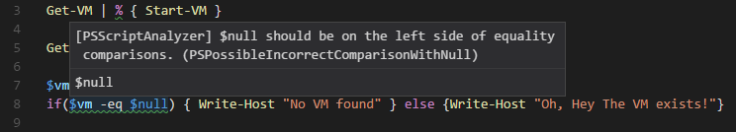
PSScriptAnalyzer
VScode Integration
What a Failure or Finding looks like:

Slide 20
PSScriptAnalyzer cont.
How to run it?
Single File:
Invoke-ScriptAnalyzer -Path .\Private\Confirm-vCenter.ps1
Directory/Tree:
Invoke-ScriptAnalyzer -Path . -Recurse
If there are no findings, there is no Output!
The Module is on GitHub, and there is a very active channel on the PowerShell Slack.
https://github.com/PowerShell/PSScriptAnalyzer
Join Slack here:
http://slack.poshcode.org/

Slide 21
PSScriptAnalyzer cont.
This is a valid variable with PowerCLI
How to ignore items that you cannot avoid.
Simply add a line, to the function file, not the test file, to suppress the warning:
[Diagnostics.CodeAnalysis.SuppressMessageAttribute("PSAvoidGlobalVars",'')]

Slide 22
Pester
PowerShell’s solution for Unit Testing.
START SMALL!
This is where the ‘1 function, 1 file’ methodology will quickly make sense.
The best ‘Getting Started’ with Pester documentation I’ve ever read was in the PowerShell Conference Book. The chapter was written by Mark Wragg.
https://leanpub.com/powershell-conference-book

Slide 23
PSCodeHealth
Wraps PSScriptAnalyzer and Pester, then makes pretty pictures!
Example:
$PSCodeHealthParameters = @{
Path = ".\FunctionBased\$Directory\"
TestsPath = ".\FunctionBased\tests\$Directory\"
HtmlReportPath = "$BaseDir\vmworldReport_$Directory.html"
PassThru = $true
}
Invoke-PSCodeHealth @PSCodeHealthParameters
https://pscodehealth.readthedocs.io/en/latest/

Slide 24
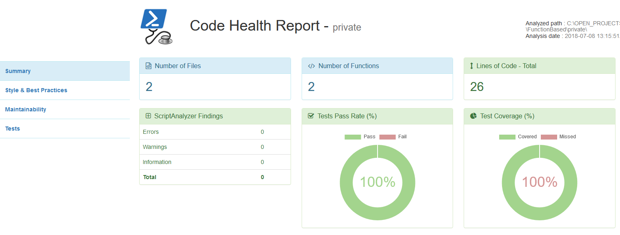
Example PSCodeHealth Report

Slide 25
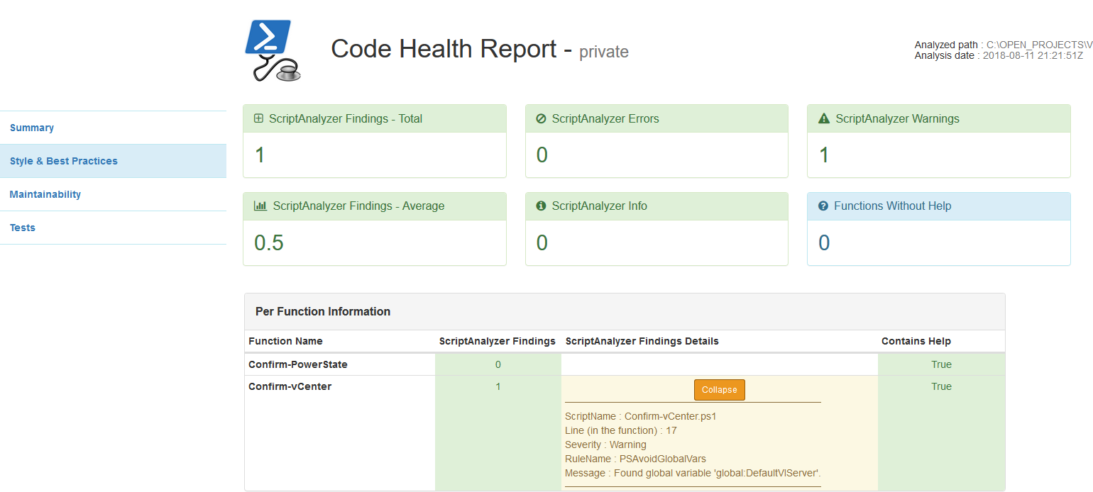
PSCodeHealth Cont.
Style & Best Practice Report:
Details Highlighted

Slide 26
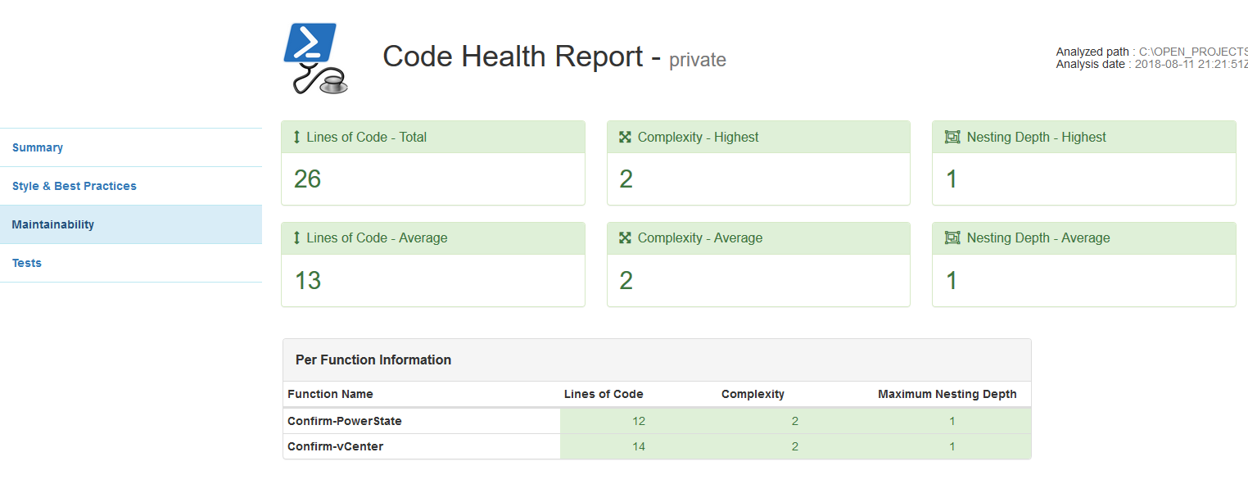
PSCodeHealth Cont.
Useful Data
Maintainability (Complexity):

Slide 27
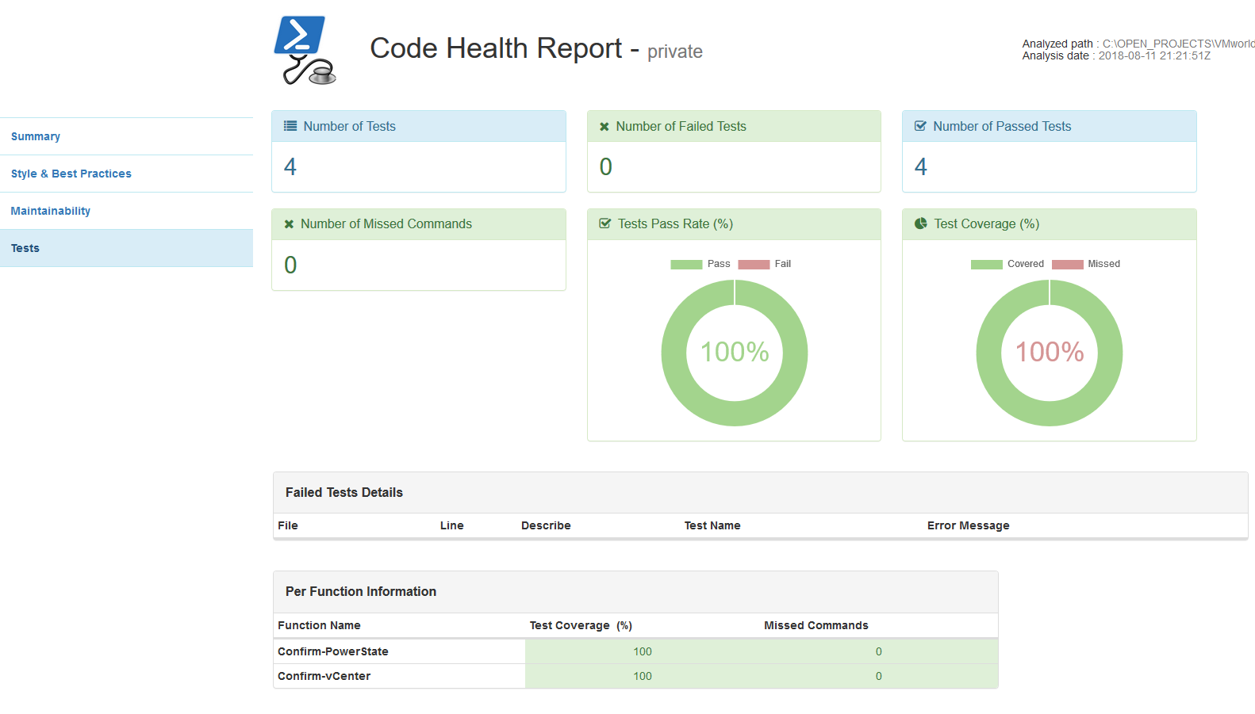
PSCodeHealth Cont.
Unit Testing
Great Summary
Fancy Charts!
Function by Function Breakdown

Slide 28
Demo-05
PSCodeHealth
Unit Tests
Style
Maintainability
Comment based Help

Slide 29

That’s a Wrap!
Feel free to Reach out to me directly.
Jpsider - (Twitter, FB, Slack, pretty much have this name everywhere)
http://invoke-automation.blog
http://belaytech.com
https://leanpub.com/powershell-conference-book
Special thanks to the DC VMUG team for their hard work
Code for this presentation available here:
https://github.com/jpsider/Invoke-Automation/tree/master/Powercli/DC_VMUG102019

